Slide 1
Part 2 : Data acquisition & processing

Slide 2
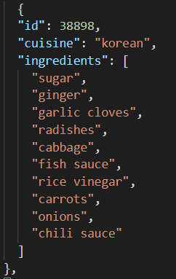
Data source
We found a data set containing many recipes on a machine learning website called Kaggle.This data set contains a lot of recipes, each recipe has a specific id and contained ingredients.
For example:
Data structure:
{
id;
cuisine;
ingredients;
}

Slide 3
Data processing
Select data set
There are a total of 49718 recipes in the original data set,
and we select some of them as our data set
Preliminary data processing
Remove the singular, plural and tense of the name of the ingredient
Relabel
Similar ingredients may not be much different,
but they are different in name

Slide 4
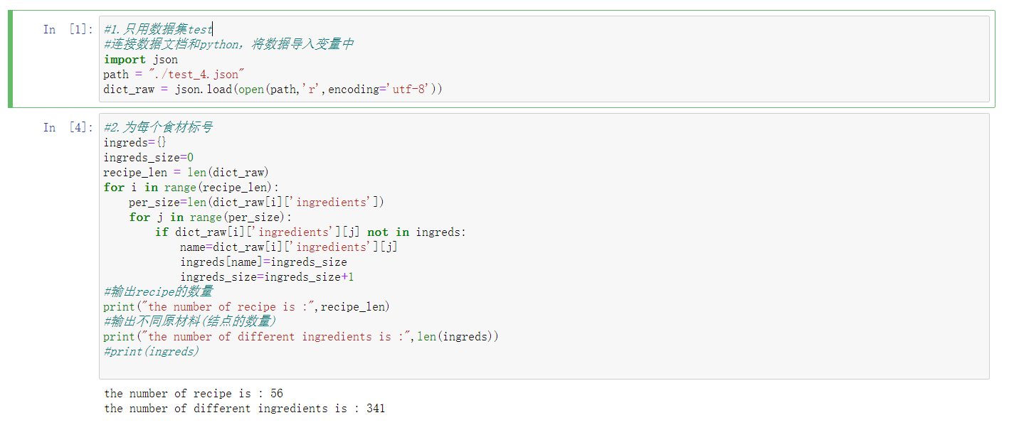
Select data set
We have selected a part of our data set.
As you can see, this data set has 56 recipes and 341 different ingredients.
This is the result after all the processing.

Slide 5


Preliminary data processing
Because the recipe contains many ingredients, the same ingredient may also have
singular and plural, tense and other changes. In order to eliminate such differences,
we consider filtering ingredients.
Before process:
We use regular expression to remove the punctuation of words, and only keep a-z,A-Z.
After process:
We use WordNetLemmatizer to remove the singular and plural, tense, and only keep the stem of the word.
Before process:
After process:

Slide 6
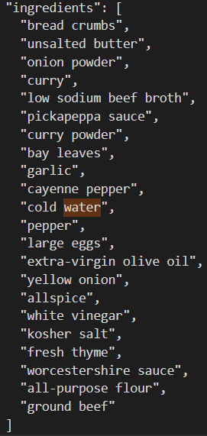
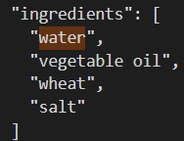
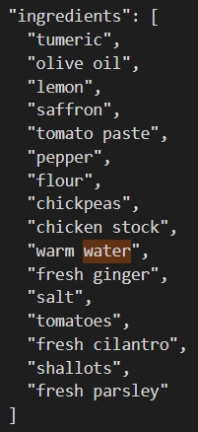
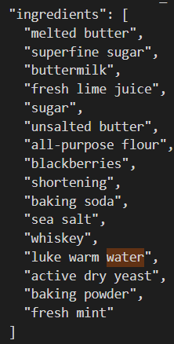
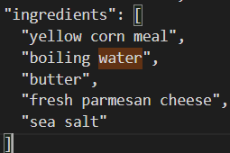
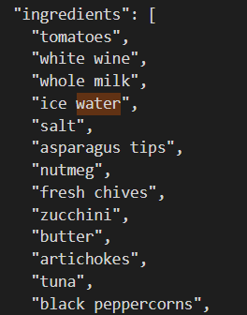
Relabel
So many water!!!
So we relabeled these ingredients
and gave these similar ingredients a common label: water

